Slide 1
Infosys SpringBoard
Virtual Internship 6.0
Food Trends And Understanding Customer Preferences
Group 1 – Batch 11
Team-B
Submitted To -
Nityasree Mam
Submitted By -
Shashank Singh
Garvit Rajpoot
Vanshika

Slide 2
Project Objective: Data-Driven Decisions
This project aims to design an end-to-end Business Intelligence solution, empowering restaurants to make data-driven decisions across various
facets of their operations.
Analyze Performance
Optimize Strategy
Improve Outcomes
Gain insights into restaurant operations, customer behavior, and service performance.
Develop effective menu strategies, delivery efficiency, and sentiment trend analysis.
Drive revenue growth, enhance operational efficiency, and boost customer satisfaction.
Project Description
The project demonstrates how data analytics can transform everyday transactional data into strategic intelligence that supports menu optimization, improved operations, and better customer experiences.
The project “Food Trends Understanding Customer Preferences” focuses on developing a comprehensive Business Intelligence solution that analyses food service data to uncover meaningful customer and operational insights.
The dashboards highlight high-demand items, profitable categories, and factors affecting customer satisfaction. This enables restaurants to optimize menus, improve service efficiency, and make data-driven business decisions.
It involves collecting, cleaning, modelling, and visualizing data related to orders, menu items, customers, delivery performance, and feedback.

Slide 3

Project Execution Milestones
Our project followed a structured approach, broken down into key milestones to ensure comprehensive development and delivery of the BI solution.
Data Collection & Preprocessing
Milestone 1
Focus on data cleaning, transformation, and robust modeling. Established a clean,
structured, and reliable data model to support accurate dashboard development.
Restaurant Performance, Customer Demographics,
and Customer Preferences
Milestone 2
Developed core business dashboards to analyse sales performance,
customer behaviour, and preference trends.
Sentiment Analysis and Fast-Food Sales insights
Milestone 3
Expanded analysis into customer feedback and advanced sales
Insights to identify satisfaction drivers and revenue trends.
Delivery Performance and Menu Optimization
Milestone 4
Integrated operational efficiency and profitability analysis to enable
data-driven strategic decision-making.

Slide 4
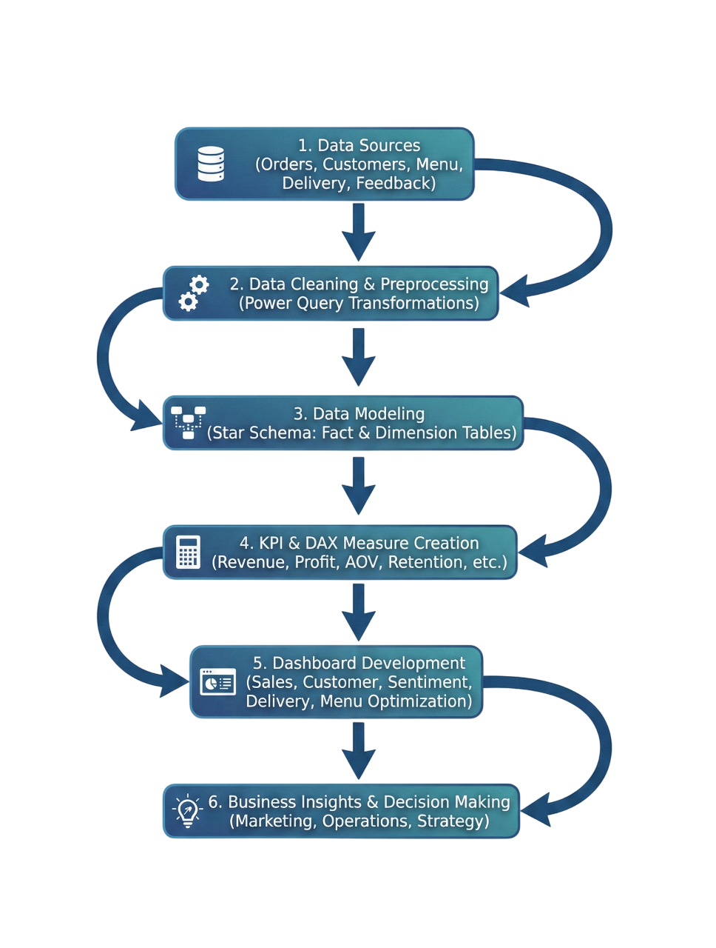
Project Workflow

Slide 5

Challenges Faced & Resolutions
Throughout the project, we encountered and successfully resolved several challenges to ensure the integrity and effectiveness of our BI solution.
1
2
Data Quality
Complex Relationships
Challenge - Poor data quality was resolved through rigorous cleaning and validation processes.
Resolution - Resolved through data cleaning, standardization, and calculated fields.
Challenge - Handled via a well-designed star schema for efficient data querying.
Resolution - Solved by designing star schema and optimized relationships
3
4
Advanced KPIs
Dashboard Clutter
Challenge - Built using sophisticated DAX expressions for accurate metrics.
Resolution - Handled using advanced DAX measures and time intelligence.
Challenge - Reduced through thoughtful redesign and user-centric layout.
Resolution - Improved layout with focused KPIs and structured dashboards.

Slide 6








Key Insights from the Dashboard
Our BI solution revealed critical insights that can directly inform strategic decisions for restaurants.
High Performer Items
Beverage Margins
These items not only generate high revenue but also maintain strong
contribution margins, making them strategically important for menu
placement and promotions.
Their consistent demand across acquisition channels suggests stable
customer preference and brand loyalty toward these products.
Beverage products demonstrate lower cost-to-price ratios, resulting in
significantly higher profit margins compared to food categories.
Upselling beverages alongside high-volume food items can substantially
increase Average Order Value (AOV) and overall profitability.
Organic Channel Retention
Delivery Delays
Organic customers show higher repeat purchase behaviour, indicating stronger brand trust and long-term engagement.
Marketing investments in SEO and brand visibility may yield better long-term ROI compared to short-term paid acquisition campaigns.
Increased delivery time directly impacts customer ratings and contributes to higher negative feedback percentages.
Operational improvements in route optimization and peak-hour resource allocation can significantly reduce delays and improve satisfaction.

Slide 7

Feature Enhancements
To further elevate the Business Intelligence solution, the following advanced analytical enhancements are proposed. These improvements aim to shift the system from descriptive and diagnostic analytics toward predictive and prescriptive decision-making, enabling proactive business strategies rather than reactive adjustments.
Predictive Analytics
Implement time-series forecasting models to predict monthly revenue and demand.
Identify seasonal sales spikes for specific menu categories (e.g., beverages during summer).
Enable demand forecasting at city and item level to optimize inventory and staffing.
Price Optimization
Analyse price sensitivity across customer segments and acquisition channels.
Identify high-volume, low-margin products suitable for price revision.
Simulate the impact of price adjustments on overall revenue and profit.
Churn Modeling
Use repeat purchase frequency and sentiment scores to predict churn probability.
Segment customers based on loyalty behaviour and purchasing patterns.
Design targeted promotional campaigns for high-risk segments.

Slide 8
Conclusion: Transforming Data into Strategy
This project successfully demonstrates the power of Business Intelligence in converting raw operational data
into actionable strategic insights.
Revenue Growth
Organic channel contributed the highest revenue (~15M), showing strong low-cost acquisition performance.
High-performing items like Sweet Lassi and Veg Cutlet significantly drive total sales volume.
Beverage category recorded the highest overall profit contribution among all categories.
Delivery Performance
Average delivery time stabilized around ~44 minutes across cities.
Delay rate (~39% on-time shown in dashboard) directly correlated with negative feedback %.
Distance analysis highlighted operational inefficiencies in long-range deliveries.
Menu Optimization
High Performer items identified using Quantity vs Profit matrix for pricing and promotion focus.
Certain high-volume items showed lower margins, indicating price optimization opportunities.
Least-performing items (e.g., low-volume wraps) flagged for repositioning or bundling strategy.
By leveraging BI, restaurants can achieve significant improvements in revenue, menu profitability, customer loyalty,
and delivery efficiency.

Slide 9

Acknowledgment
We would like to express our heartfelt gratitude to:
Infosys Springboard Team– for organizing this valuable internship opportunity.
Our Mentor(Nityasree mam) - for her continuous support and feedback.
My Teammates(Garvit Rajpoot, Vanshika) – for collaboration, encouragement,
and insights. This internship has been a significant step in our professional growth
and technical journey.
Microsoft Power BI Documentation - Food_trend.pbix
Infosys Springboard Virtual Internship course materials - dim_customer.csv,
dim_delivery_partner_.csv, dim_menu_item.csv, dim_restaurant.csv,
fact_delivery_performance.csv, fact_order_items.csv, fact_orders.csv,
fact_ratings.csv, Balaji Fast Food Sales.csv
Data Sources – Dataful and Kaggle
References

Slide 10
Thank You

